Slide 1


Slide 2

Agenda
Problem Statement 03
Data Mining - 01 04
Data Mining - 02 05
Exploratory Data Analysis (EDA) 06
Data Visualization 07
Algorithms Used 08
Analysis of Results 09
Conclusion & Future Work 10

Slide 3
Problem Statement
With the increasing number of insurance claims being filed daily, insurance companies face significant challenges in identifying fraudulent claims. Fraudulent claims lead to financial losses and can undermine the trust between insurers and policyholders. To address this issue, we aim to develop a predictive model using machine learning algorithms that can accurately detect and flag potential fraudulent insurance claims.
By successfully developing an accurate and efficient fraud detection model, insurance companies can significantly reduce financial losses due to fraudulent claims, streamline their claim processing workflows, and enhance their overall risk management strategy.

Slide 4
Data Mining - 01
Importing libraries
Load the Insurance Claim dataset
Dropped Unnecessary columns.
Checking for Duplicate Values, Null values and Unique value
Display the ‘CLM_PMT_AMT' variable by sub-variable count
Use LabelEncoder to handle categorical data
Using imputing techniques like KNN Imputer and simple imputer
Identifying the independent and target variables
splitting the dataset into train and test
Identify variable which are suppose to normalize the values
To build the ‘Insuranceclaim' model with random sampling

Slide 5
Data Mining - 02
Merge two Dataframes on index of both the data frames
Load the results dataset
Build the Regression models and compare the results.
Results with comparing the all the algorithms
To build the ‘Support Vector Regression(SVR)’model with random sampling
Final results

Slide 6
Exploratory Data Analysis (EDA)
Data Overview: The dataset contains 678014 rows and 12 columns DESYNPUF_ID, CLM_ID, SEGMENT, CLM_FROM_DT, CLM_THRU_DT, PRVDR_NUM, CLM_PMT_AMT, NCH_PRMRY_PYR_CLM_PD_AMT, AT_PHYSN_NPI, CLM_ADMSN_DT, ADMTNG_ICD9_DGNS_CD, CLM_PASS_THRU_PER_DIEM_AMT, NCH_BENE_IP_DDCTBL_AMT, NCH_BENE_PTA_COINSRNC_LBLTY_AM, NCH_BENE_BLOOD_DDCTBL_LBLTY_AM, CLM_UTLZTN_DAY_CNT, NCH_BENE_DSCHRG_DT, CLM_DRG_CD, ICD9_DGNS_CD_1, ICD9_DGNS_CD_2, ICD9_DGNS_CD_3, ICD9_DGNS_CD_4, ICD9_DGNS_CD_5, ICD9_DGNS_CD_6, ICD9_DGNS_CD_7, BENE_SEX_IDENT_CD, BENE_RACE_CD, SP_STATE_CODE, BENE_COUNTY_CD, SP_ALZHDMTA, SP_CHF, SP_CHRNKIDN, SP_CNCR, SP_COPD, SP_DEPRESSN, SP_DIABETES, SP_ISCHMCHT, SP_OSTEOPRS, SP_RA_OA, SP_STRKETIA, Total_mons, CLM_PMT_AMT_A, CLM_PMT_AMT_P, and %Error
Claim amount: Calculate the call amount by analyzing the ‘CLM_PMT_AMT' column.
Duplicate Values: There are duplicate values in the dataset. In the combined dataset ‘claim’
Missing Values: There are no missing values
Categorical Variables(D1): Categorical variables include ADMTNG_ICD9_DGNS_CDBENE_RACE_CDBENE_SEX_IDENT_CDCLM_DRG_CDCLM_IDPRVDR_NUMSEGMENTSP_ALZHDMTASP_CHFSP_CHRNKIDNSP_CNCRSP_COPDSP_DEPRESSNSP_DIABETESSP_ISCHMCHTSP_OSTEOPRSSP_RA_OASP_STATE_CODE
Numerical Variables(D1): Numerical variables include AT_PHYSN_NPICLM_ADMSN_DTCLM_FROM_DTCLM_PMT_AMTCLM_PASS_THRU_PER_DIEM_AMTCLM_PMT_AMT_ACLM_PMT_AMT_PCLM_THRU_DTCLM_UTLZTN_DAY_CNTNCH_BENE_BLOOD_DDCTBL_LBLTY_AMNCH_BENE_DSCHRG_DTNCH_BENE_IP_DDCTBL_AMTNCH_BENE_PTA_COINSRNC_LBLTY_AMNCH_PRMRY_PYR_CLM_PD_AMT Total_mons
Relationship Between Variables: Identify correlations and relationships between different variables and target variable to understand which features may be more relevant for getting CLM_PMT_AMT.

Slide 7
Data Visualization
The dataset had each and every details required for Insurance claim dataset and Visualization is performed.
Our target is “CLM_PMT_AMT” and based on this the data varies.
There were some columns which are not affecting the Target.
To get the “Final CLM_PMT_AMT”, we must perform some algorithms in our dataset.
Divide them into train and test dataset.
Performing feature scaling to fit the train and test data properly.

Slide 8
Algorithms Used
LinearRegression
DecisionTreeRegressor
RandomForestRegressor
ExtraTreesRegressor
KNeighborsRegressor

Slide 9
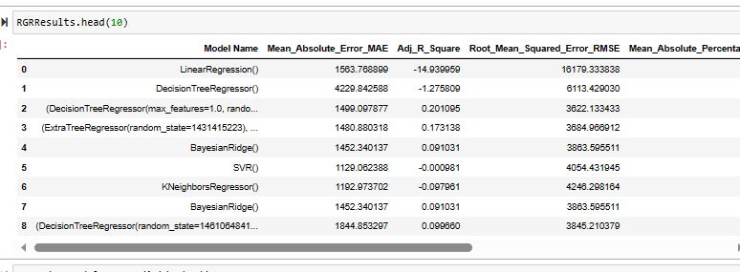
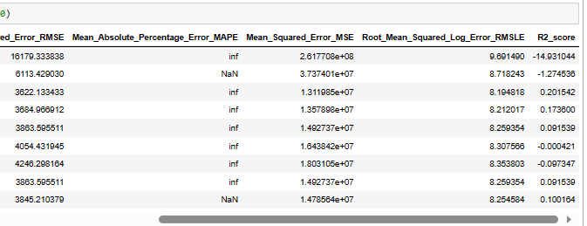
Analysis of Results

Slide 10
Conclusion and Future Work
Conclusion: Based on provided metrics, the ExtraTreeClassifier model achieved the high balanced accuracy, and has a good balance between precision and recall. Also has a high ROC_AUC score compared to all the other algorithms. Therefore, this model is good for handling class imbalances and providing balanced view of overall performance.
Future Work:
Feature Engineering and Selection
Hyperparameter Tuning
Ensemble Methods
Model Deployment:

Slide 11
Thank You
Q & A
Student Name: Nadimpalli Sai Pramod
Roll Number: 222010311021
GITAM University
Mobile: +91 7993614777
Email: snadimpa@gitam.in
Hyderabad - India

